Slide 1

Energy Consumption Forecasting Pipeline
Presented By:
1. Ravindra Mukkapati 2. Venkatesh Marupaka
3. Archana Manjunath Reddy 4. Eswari Akshaya Angarapu

Slide 2
Projective Overview and Objective
Technical Specifications
Design solutions with HLD and LLD
Development of Lakehouse in Databricks
Testing the ETL pipelines in AWS and DataBricks
Business Outcomes

Slide 3
Projective Overview and Objective
This project builds an automated Energy Consumption Forecasting Pipeline using AWS and Databricks. Raw energy data from S3 is processed through Bronze, Silver, and Gold layers with Glue and Delta Lake. The pipeline ensures data cleaning, quality checks, error handling, and alerts, delivering reliable datasets for forecasting energy demand.
Primary Goals:
Build a scalable data pipeline using AWS + Databricks to automate ingestion, cleaning, and transformation.
Ensure reliable and high-quality data with governance, error handling, and monitoring.
Enable accurate energy forecasting through feature-rich datasets in the Gold layer.

Slide 4
Business / Technical Specifications
Build ETL Pipelines using AWS, DATABRICKS Kaggle Dataset as source for performing below activities:
Automated Data Pipeline – Ingest raw energy data from AWS S3 using AWS Glue and process it in Databricks.
Medallion Architecture – Organize data into Bronze (raw), Silver (cleaned), and Gold (analytics-ready) layers.
Data Quality & Reliability – Ensure deduplication, schema validation, error logging (CloudWatch), and anomaly detection.
Orchestration & Collaboration – Use Databricks Workflows for scheduling and Git (CodeCommit) for version control.
Scalable Forecasting Platform – Leverage Delta Lake and PySpark to enable accurate energy forecasting and business insights.

Slide 5
Design Solutions for building pipelines
High Level Design
Low Level Design

Slide 6
High Level Design

Slide 7
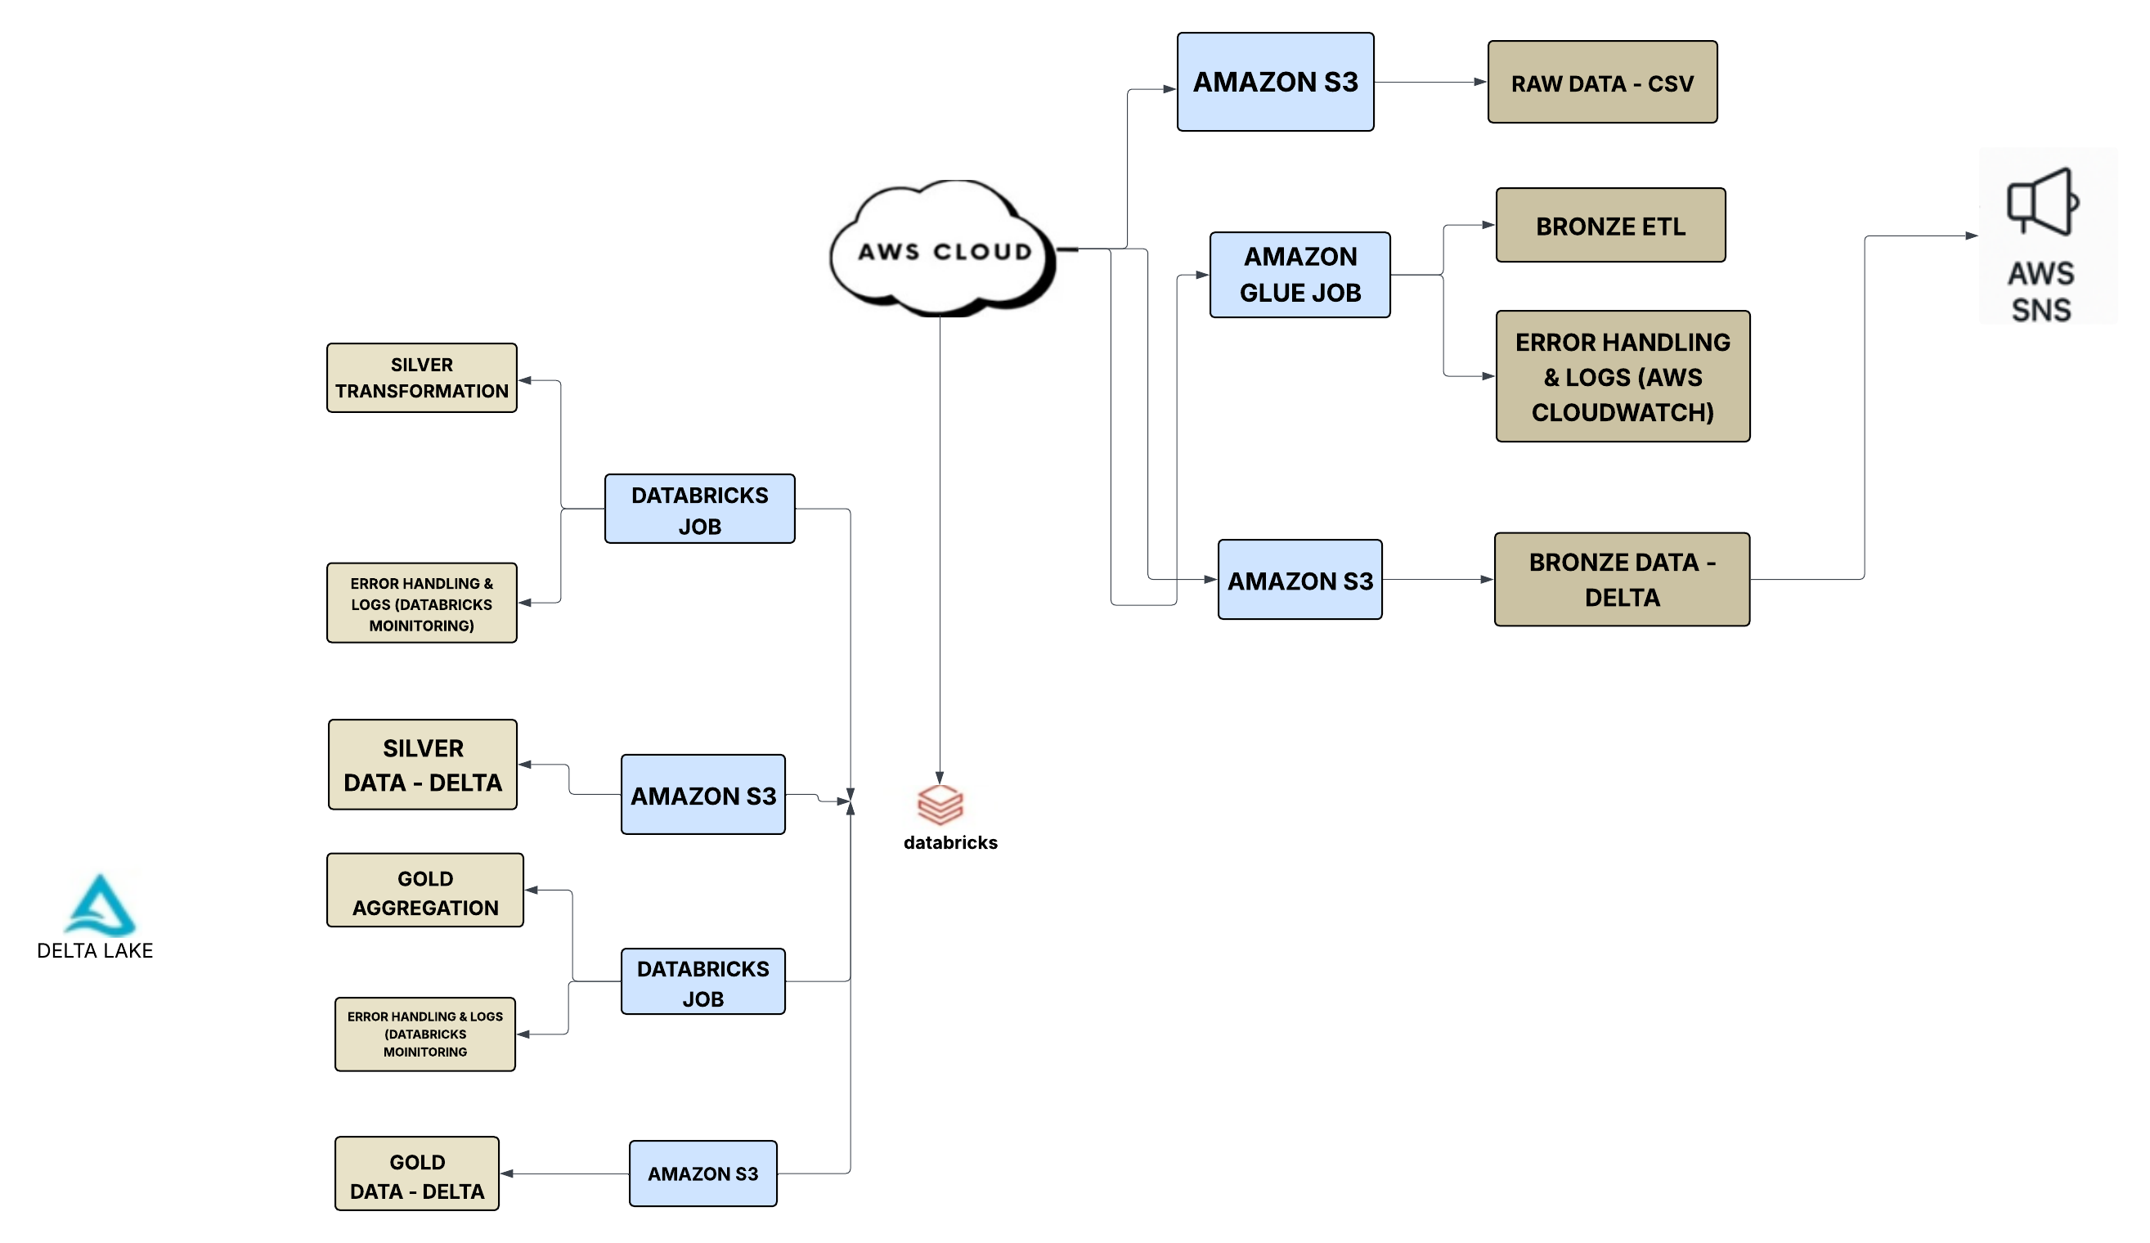
Energy Consumption Forecasting Pipeline

Slide 8
Low Level Design

Slide 9
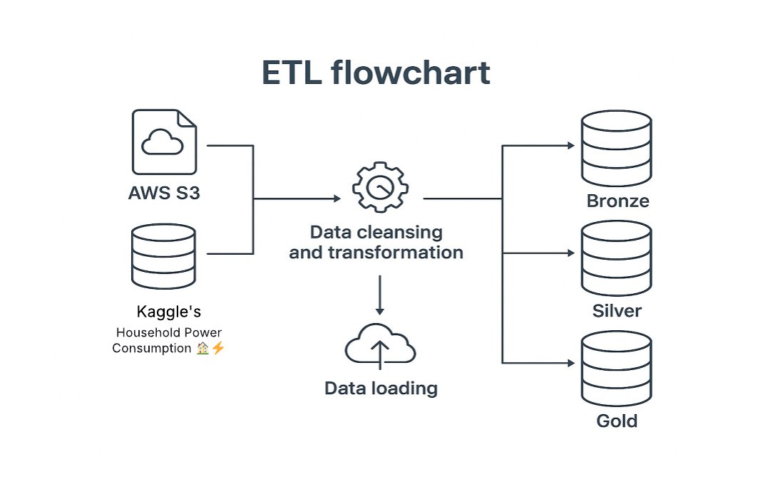
Building ETL Pipelines in AWS and Databricks

Slide 10
Building ETL Pipelines in AWS and Databricks
Pipeline Orchestration in AWS AND DATABRICKS
Error Handling mechanisms in AWS AND DATABRICKS
Data Quality checks using DLT expectations and other approaches
Building ALERTS , Audit and error logs in Databricks
Data Visualisation for better analysis
Git Integration

Slide 11
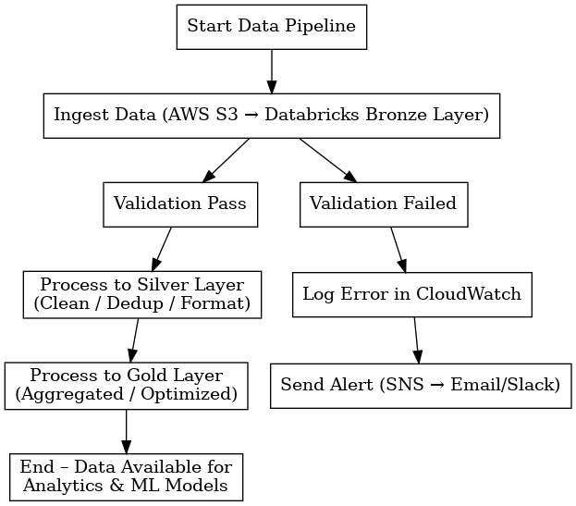
ERROR HANDLING
CloudWatch Logs – Tracks ingestion failures by capturing error messages, timestamps, and metadata for debugging.
Try/Except with Logging in Databricks – Wraps critical Spark operations to catch runtime errors and logs them for analysis.

Slide 12
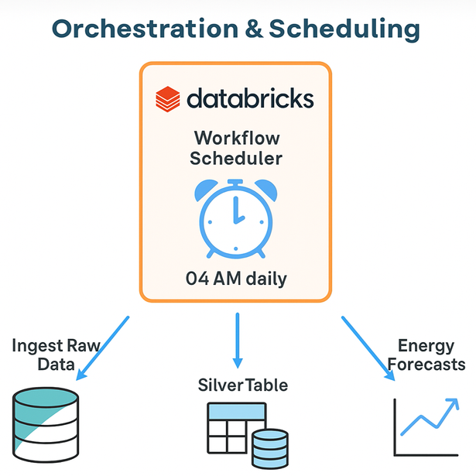
Orchestration & Scheduling
Our project builds a scalable data pipeline for the energy sector using AWS Glue, S3, and Databricks.
We use the Medallion Architecture (Bronze–Silver–Gold) to ingest, clean, and enrich raw data.
AWS Glue automates ETL and cataloging, while Databricks handles transformations, ML, and forecasting.
The result is clean data, accurate forecasts, anomaly detection, and actionable insights for energy management.

Slide 13
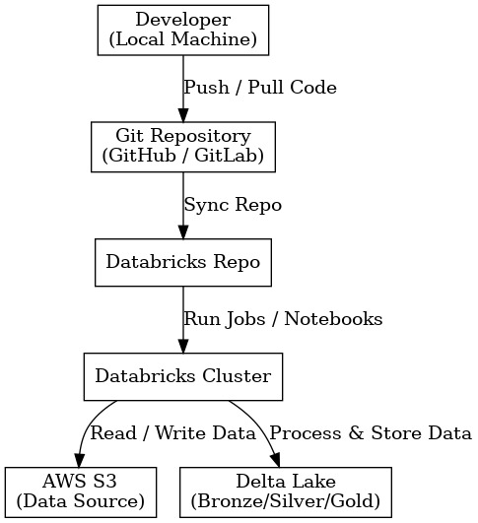
GIT Integration
Workflow:
Developer Workflow
Write notebooks locally or in Databricks.
Commit and push changes to Git repository.
Databricks Repo Sync
Connect Databricks to Git (via personal access token).
Pull latest code or push updates directly from Databricks.
Execution on AWS
Code executed on Databricks clusters.
Data sourced from AWS S3 and stored in Delta Lake (Bronze → Silver → Gold).
Deployment & CI/CD
Integrate with AWS CodePipeline or GitHub Actions for automated deployment.

Slide 14
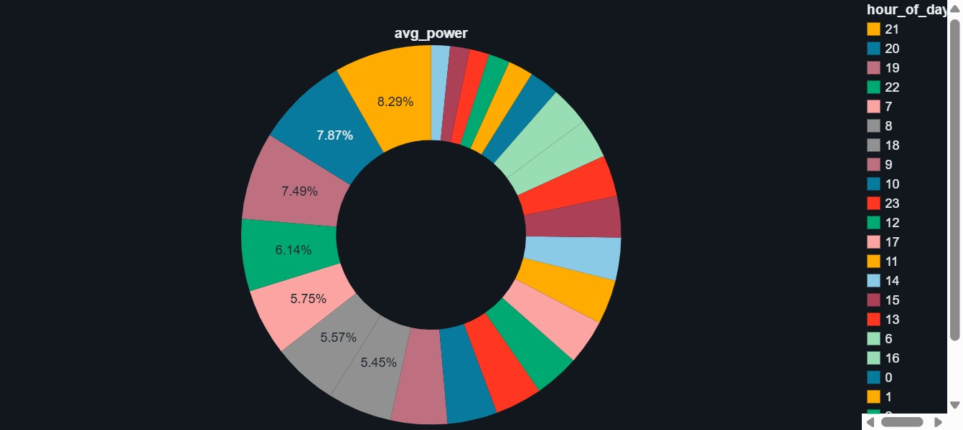
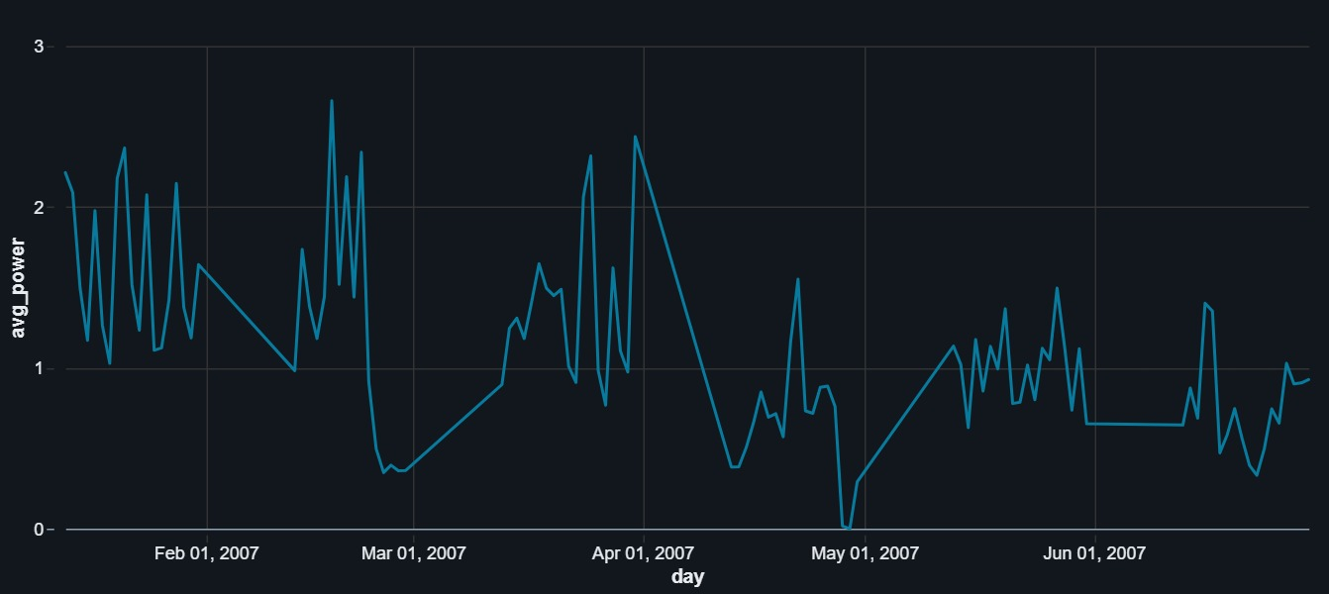
Visualizations
Hourly consumption pattern
Peak consumption is observed in the evening hours (19–22 hrs), showing highest demand.
Early mornings (0–6 hrs) show minimal usage, indicating low household activity.
Helps in forecasting demand patterns for efficient energy planning.
Daily Average Power Consumption
The chart shows fluctuations in daily average power usage, with noticeable peaks around February and April.
A significant drop is observed during late April to May, indicating reduced energy consumption.
The trend stabilizes in June, highlighting seasonal and behavioral impacts on daily consumption.

Slide 15
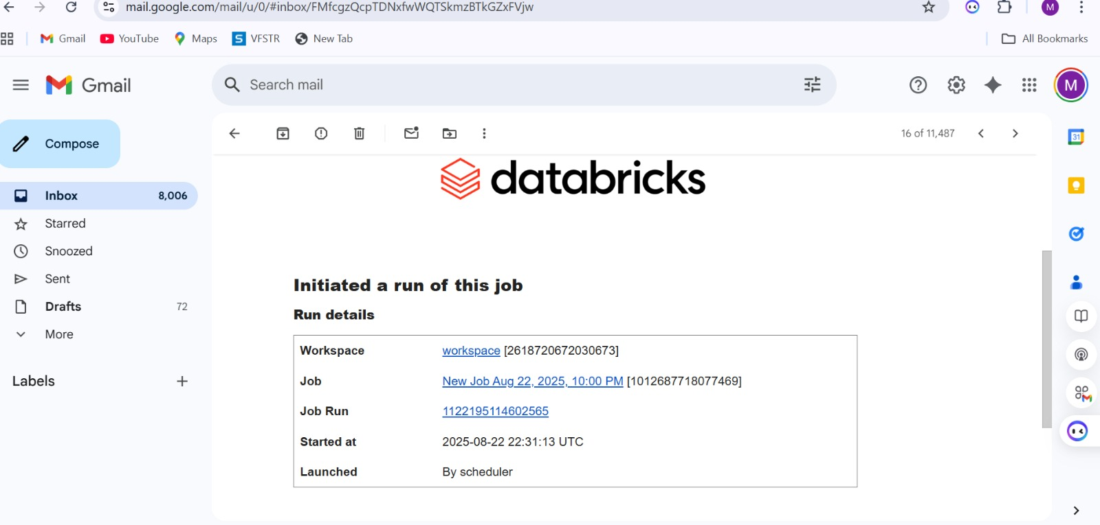
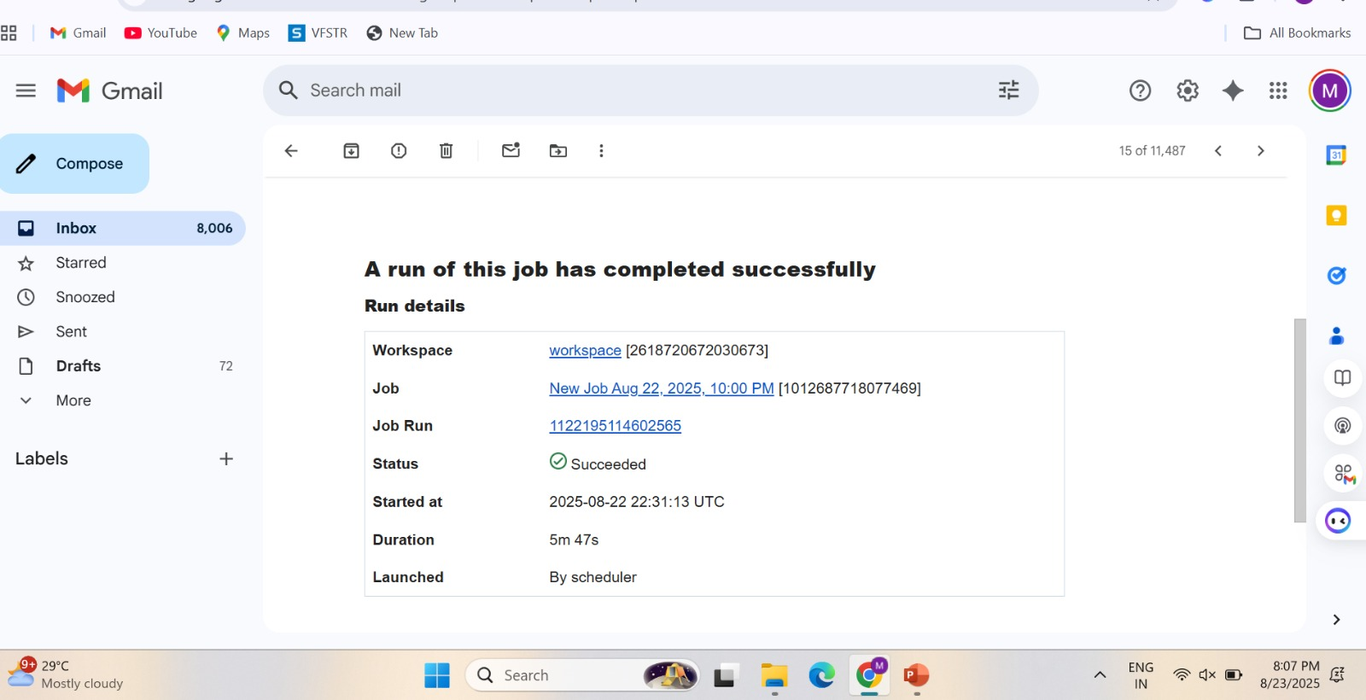
Alerts & Notifications

Slide 16
Testing
Schema Validation – Check if all columns (timestamp, voltage, power, etc.) exist with correct data types.
Data Quality Checks – Ensure no nulls, duplicates, or invalid values (e.g., negative power usage).
Transformation Validation – Verify Silver → Gold transformations like aggregations and feature creation.
Error Handling – Test with bad inputs to confirm errors are logged in CloudWatch/Logging Table.
End-to-End Pipeline Test – Run a small dataset through Bronze → Silver → Gold and validate outputs.
.

Slide 17
Business Outcomes
Built a scalable ETL pipeline for energy forecasting.
Optimized Bronze, Silver, Gold tables ready for analytics & ML.
Monitoring & alerts ensure less downtime, more trust.
Business users can see past trends & future predictions.
Improved energy planning & cost efficiency with accurate forecasts.

Slide 18
Thank you

